Slide 1
Prompting for Precision
Designing Effective AI Queries in Higher Education

Slide 2
Why Prompting Matters
AI outputs depend on input quality
Vague prompts = vague results
Precise prompts = usable outputs

Slide 3
Session Objectives
Identify elements of effective prompts
Apply strategies to improve outputs
Design prompts for teaching, research, workflows

Slide 4
What Is a Prompt?
Instruction given to AI
Includes task, context, constraints, format

Slide 5
Weak vs. Strong Prompts
Weak: Explain this topic
Strong: Explain formative assessment for first-year students in 3 bullet points

Slide 6
Prompt Framework
Role
Task
Context
Format

Slide 7
Framework Example
Act as an instructional designer
Create a 10-min activity for biology class
Include steps and outcomes
Provide PowerPoint and worksheet that goes along with the lesson

Slide 8
Be Specific
Define audience
Define purpose
Define scope

Slide 9
Add Constraints
Length
Format
Tone

Slide 10
Use Iteration
Start simple
1
Refine output
2
Ask follow-ups
3

Slide 11
Common Mistakes
Too vague
Missing context
No format
Expecting perfection

Slide 12
Teaching Applications
Lesson plans
Discussion questions
Differentiation

Slide 13
Practice Scenario: Teaching
Context: First-year course, mixed readiness
Task: Create a 15-min activity
Challenge: Include differentiation + steps
Starter: Create a classroom activity about [topic].

Slide 14
Teaching Prompt, revised
Act as an instructional designer. Create a 15-minute active learning activity for a first-year undergraduate course with students at varying levels of readiness. Include step-by-step instructions, differentiation strategies to support diverse learners, and clear learning outcomes.

Slide 15
Additional Sample Teaching Prompts
Act as an instructional designer. Create a 50-minute lesson plan for an upper-level undergraduate course on [topic]. Include learning objectives, a lecture outline, an active learning activity, and a formative assessment.
Generate 6 discussion questions for a graduate seminar on [topic]. Include a mix of comprehension, application, and critical thinking questions.
Design two versions of a learning activity for an introductory course: one for foundational learners and one for advanced learners. Include instructions and outcomes.

Slide 16
Research Applications
Summarize articles
Literature outlines
Refine questions

Slide 17
Practice Scenario: Research
Context: New literature review topic
Task: Identify themes + gaps
Challenge: Structured overview + questions
Starter: Summarize research on [topic].

Slide 18
Research Prompt, revised
Act as a research assistant. Provide a structured overview of current peer-reviewed research on [topic]. Identify 3–5 major themes, highlight gaps in the literature, and suggest 2–3 potential research questions for further study.

Slide 19
Additional Sample Research Prompts
Act as a research assistant. Organize peer-reviewed literature on [topic] into themes. Summarize each theme and note methodologies.
Refine the following research idea into 3 clear research questions suitable for higher education research: [idea].
Suggest appropriate research methods for studying [topic]. Compare qualitative and quantitative approaches with strengths and limitations.

Slide 20
Workflow Applications
Draft emails
Create rubrics
Design materials

Slide 21
Practice Scenario: Workflow
Context: You need to create a rubric for a student assignment
Task: Develop clear criteria and performance levels
Challenge: Align the rubric with learning outcomes and ensure clarity
Starter Prompt: Create a rubric for the attached assignment.

Slide 22
Workflow Prompt, revised
Act as an instructional designer. Create an analytic rubric for a 5-page undergraduate research paper. Include 4–5 criteria (such as argument, use of evidence, organization, and writing quality), with four performance levels and clear, specific descriptors for each level.

Slide 23
Additional Sample Workflow Prompts
Create an analytic rubric for a 5-page undergraduate research paper with 4–5 criteria and 4 performance levels.
Draft a professional email responding to a student requesting an extension. Maintain a supportive but policy-aligned tone.
Write a clear syllabus statement about late work policies that balances flexibility and accountability.

Slide 24
Ethical Considerations
Verify outputs
Protect data
Maintain integrity

Slide 25
Key Takeaways
Prompting is a skill
Structure improves results
Iteration is essential

Slide 26
Q&A
Questions and discussion

Slide 27
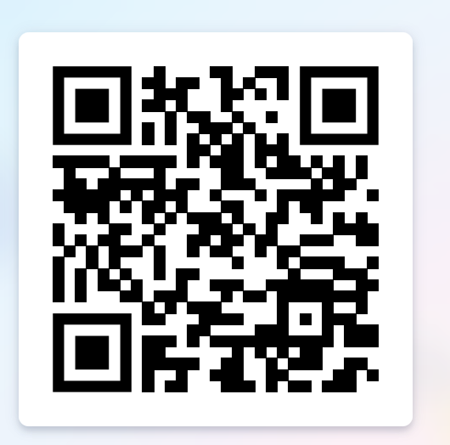
Thank You
AXB199@SHSU.EDU
Feedback

